Slide 1

Case Study Roman Urdu Sentiment Identification
Senior Data Scientist Role - Amazon Pxt Group
Joseph Girsch
12/22/2023

Slide 2
Outline
Case Study Overview
Data Overview
Data Cleaning Summary
Language Detection
Feature Extraction
Model Development
Results
Feature Importances for Negative Sentiment Prediction
Data Limitations
Business Implications

Slide 3
Case Study Overview
Goal: Train a sentiment classifier for the social media posts of the under-resourced Roman Urdu language.
Special focus on Negative sentiment over Positive or Neutral sentiments.
Challenges:
Provided data is contaminated and requires processing.
Traditional NLP tools do not support Roman Urdu.
Notes:
NLP: Natural Language Processing

Slide 4
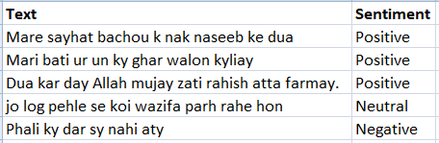
Data Overview
The Roman Urdu data set is a limited corpus containing 20,229 records
When processed, each record contains two columns:
A ‘Text’ column containing the corpus of social media posts
A ‘Sentiment’ column containing the general sentiment of the row (Positive, Neutral, or Negative)
Corpus sample
Sentiment | Row Count
Positive | 6,013
Neutral | 8,929
Negative | 5,287
Notes:
# Roman Urdu Data Citation: Sharf,Zareen. (2018). Roman Urdu Data Set. UCI Machine Learning Repository. https://doi.org/10.24432/C58325.

Slide 5
Data Cleaning Summary
Observation | Action Taken
No field headers | Designate field names
Corrupted Sentiment values | Regex to streamline
112 text rows containing only blank values | Rows deleted
The 3rd column is 99.96% null | Dropped the column
Rows with other languages | Intermediate language detection step required.
Remaining rows after processing and removing duplicates: 19,648
Notes:
Note: Results may vary from run to run

Slide 6
Language Detection
Challenge: While language detection is supported for the Urdu language itself by Python’s ‘langdetect’ and the AWS’ Comprehend service, no commonly known package or service supports the Roman script of the Urdu language.
Solution: Wrap batches of the corpus in prompt text and systematically loop through OpenAI’s API to determine each row’s dominant language.
Roman Urdu: 18,870*
Other languages removed: 778*
*Results varies slightly from run to run
Notes:
Note: Results may vary from run to run

Slide 7
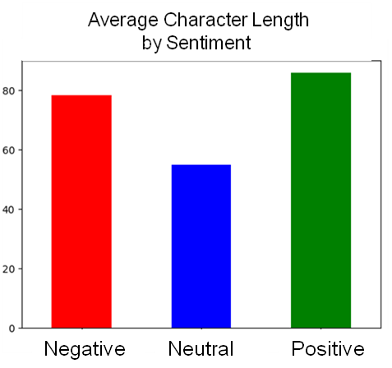
Feature Extraction
Primary source of features: TF-IDF Vectorizer.
A TF-IDF (Term Frequency-Inverse Document Frequency) vectorizer converts the Roman Urdu text into numerical features that machine learning algorithms can work with effectively.
See notes for more detailed explanation of TF-IDF Vectorizer.
Text length was discovered to be a differentiating feature between Neutral sentiments and Positive or Negative sentiments, as seen in chart on right.
Notes:
Note: Results may vary from run to run
A TF-IDF Vectorizer, which stands for Term Frequency-Inverse Document Frequency Vectorizer, is a text processing tool used in natural language processing and information retrieval. It transforms a collection of textual documents into a numerical format by representing each document as a vector. In this representation, each unique word or term in the corpus is assigned a numerical value based on its frequency within the document (Term Frequency) and its importance across the entire corpus (Inverse Document Frequency). TF-IDF assigns higher values to terms that are frequent within a document but relatively rare across all documents, allowing it to capture the importance of words in distinguishing one document from another. This vectorization technique is widely used in tasks such as text classification, document clustering, and information retrieval to convert unstructured text data into a format suitable for machine learning algorithms.
Formulas:
TF(t, d) = (Number of times term t appears in document d) / (Total number of terms in document d)
IDF(t) = log(N / (Number of documents containing term t))
TF-IDF(t, d) = TF(t, d) * IDF(t)

Slide 8
Model Development
A sample of four models were evaluated for this case study.
Models were evaluated on an 80/20 training-test split using the micro-accuracy metric.
Model hyperparameters were tuned using the grid search cross validation technique.
Metrics shown below.
Model | Micro-accuracy | “Negative” Accuracy | Weighted F1-Score | “Negative” F1-Score
LinearSVC | 0.630 | 0.763 | 0.629 | 0.588
LGBMClassifier | 0.621 | 0.765 | 0.617 | 0.541
SGDClassifier | 0.649 | 0.792 | 0.647 | 0.589
LogisticRegression | 0.634 | 0.782 | 0.632 | 0.584
Notes:
Note: Results may vary from run to run

Slide 9
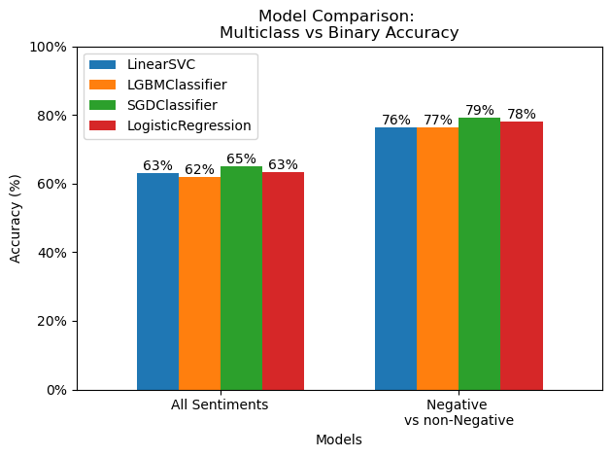
Results
The SGDClassifier had the best performance of all the models (64.9% Accuracy).
However, if the stakeholders were willing to accept distinguishing only between Negative and non-Negative sentiments, Accuracy could be increased from 64.9% to 79.2%.
3 labels to 2 labels
Little difference in real performance between the four models.
Notes:
Note: Results may vary from run to run

Slide 10
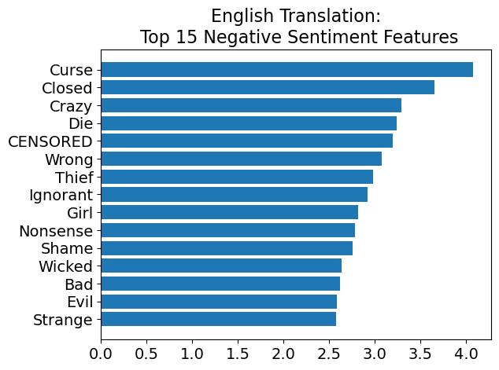
Feature Importances for Negative Sentiment Prediction
Displayed on the right are the strongest predictors of Negative Roman Urdu Sentiment.
Translation courtesy of the OpenAI API.
As one can see, Social Media can be a scary place in any language.
Notes:
Note: Results may vary from run to run

Slide 11
Data Limitations
Limitation:
What amounts to about 20,000 rows of corrupted sentence fragments is not a large body of text to train a language model in the grand scheme of machine learning.
Potential Solutions for Future:
Perhaps a larger corpus of Roman Urdu text could be scraped from the web to improve sentiment prediction accuracy.

Slide 12
Summary
Roman Urdu, while not currently well supported by language services, can be successfully modeled when used with AI-powered large language models.
All machine learning models tested perform roughly on par with each other.
More data is required to greatly increase prediction accuracy
A binary Negative Sentiment detection model has higher accuracy for the same amount of data than its multiclass counterpart.

Slide 13
Business Implications
OpenAI API can act as a substitute for the ‘langdetect’ Python package or AWS’ Comprehend service until they support Roman Urdu language detection.
The simplified binary Negative Sentiment detection model requires less data to be accurate.

Slide 14
Backup

Slide 15
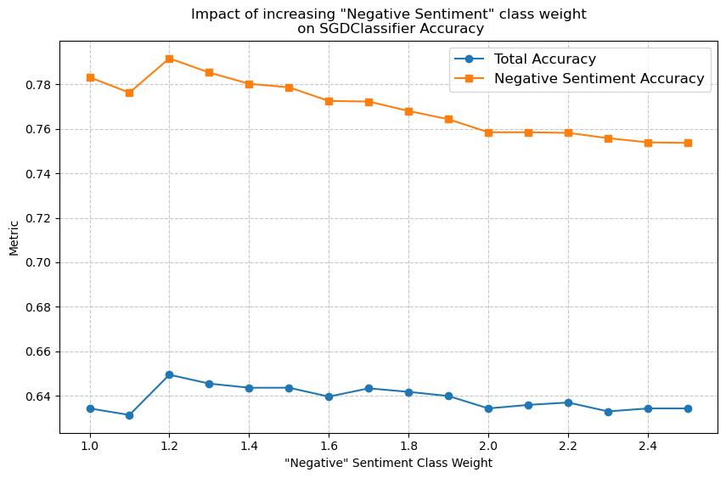
Lessons Learned
Urdu and Roman Urdu are distinct languages.
I built and debugged a language detection model using boto3 only to realize that Roman Urdu wasn’t supported.
The chart on the right shows that no tradeoff exists between total accuracy and negative sentiment accuracy when adjusting class_weight toward the Negative Sentiment.
In fact adjusting the class_weight even gave a slight boost to both Accuracy measures before both began to degrade after Negative Sentiment exceeded a class_weight value of 1.2.

Slide 16
Python Packages Used
Sklearn
lightGBM
OpenAI
Matplotlib
Re
Pandas
Numpy

